Slide 1
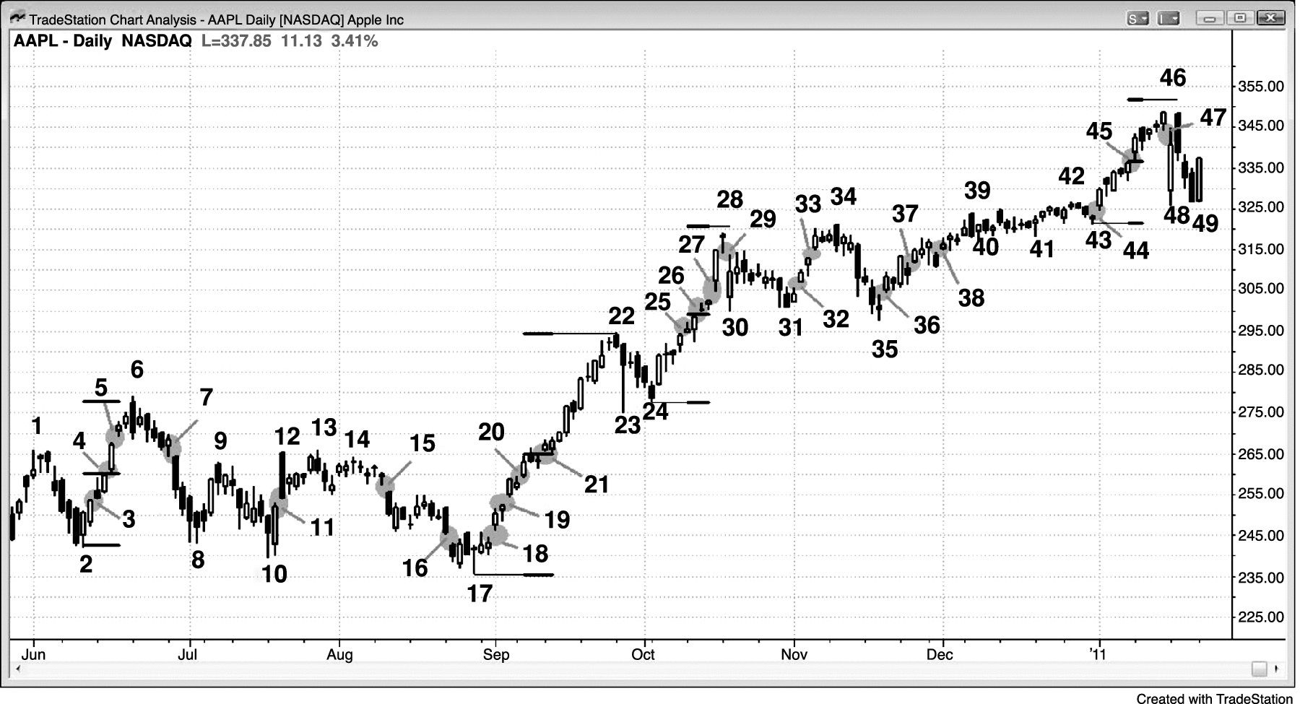
FIGURE 6.1 Many Types of Gaps on a Daily Chart

Slide 2
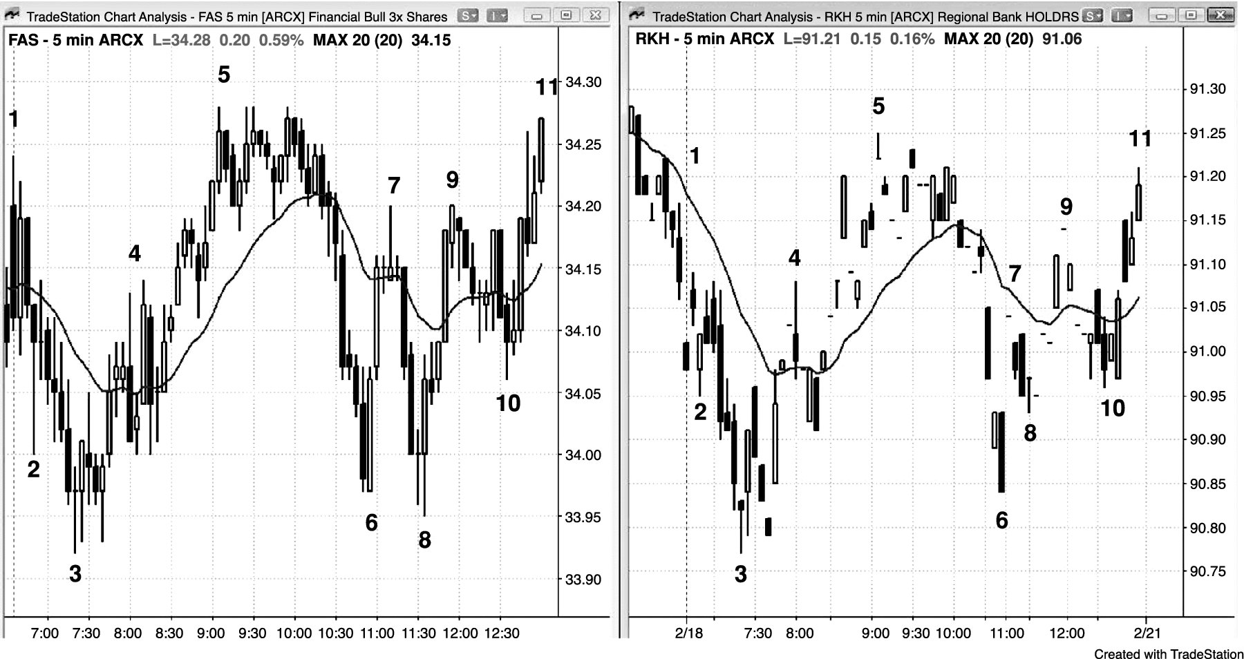
FIGURE 6.2 Trend Bars Are the Same as Gaps

Slide 3
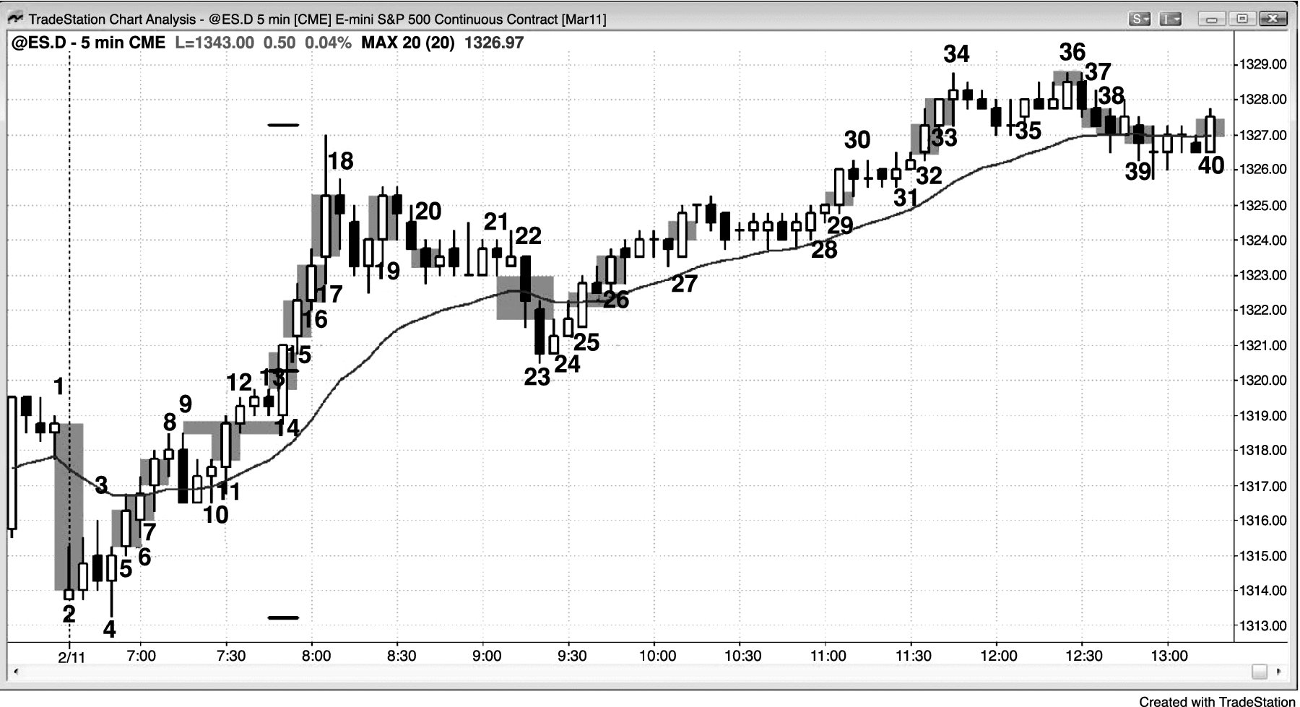
FIGURE 6.3 Trend Bars Are Gaps

Slide 4
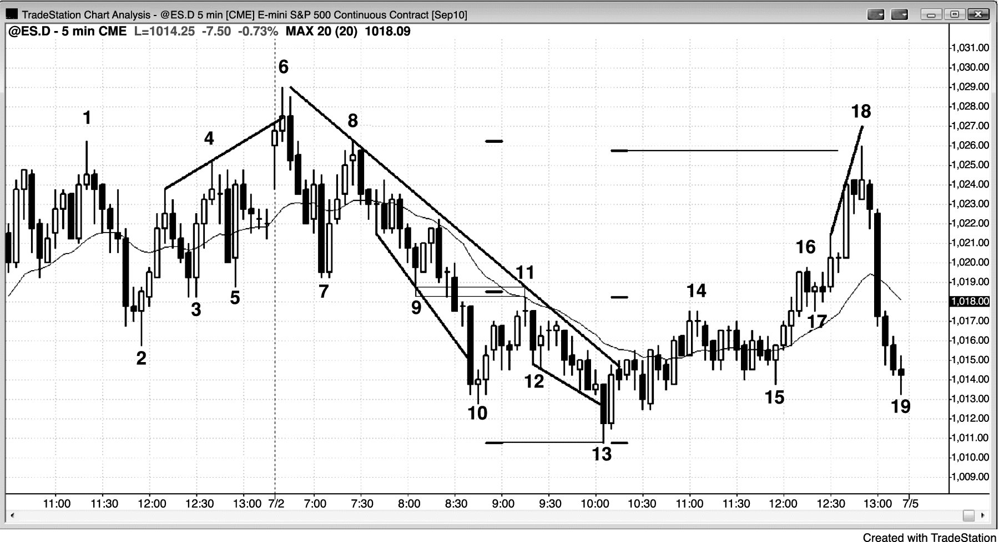
FIGURE 6.4 Intraday Gaps

Slide 5
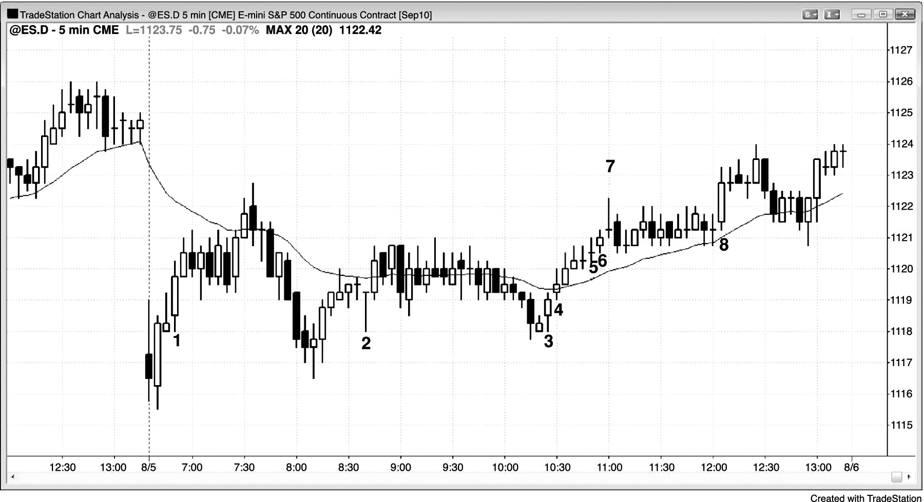
FIGURE 6.5 Gap between the Open of a Bar and the Close of the Prior Bar

